Slide 1
Presented by Radhe shyam
VOICE BASED EMAIL SYSTEM FOR BLINDS

Slide 2
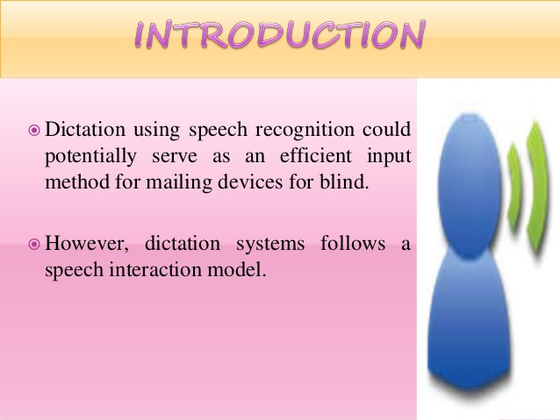

Slide 3
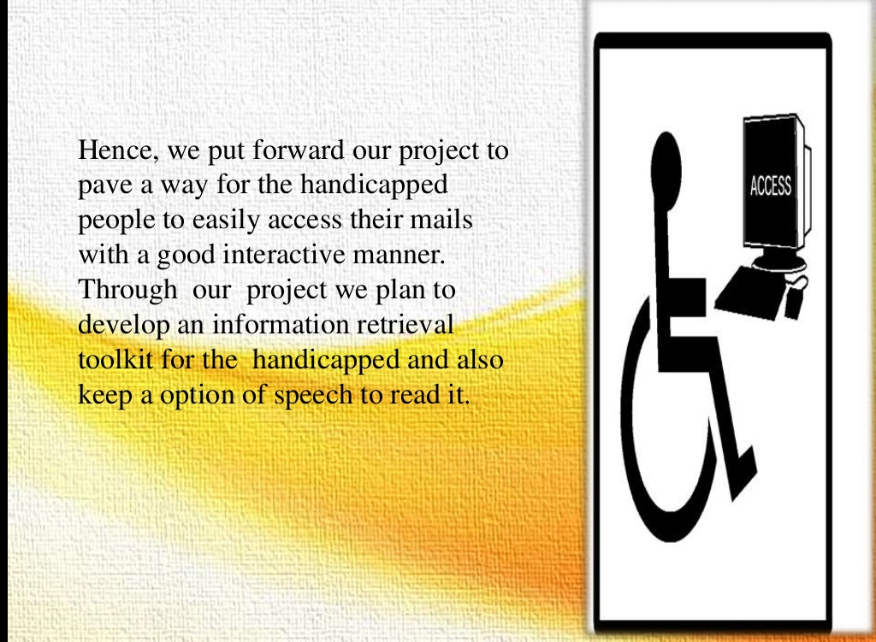

Slide 4
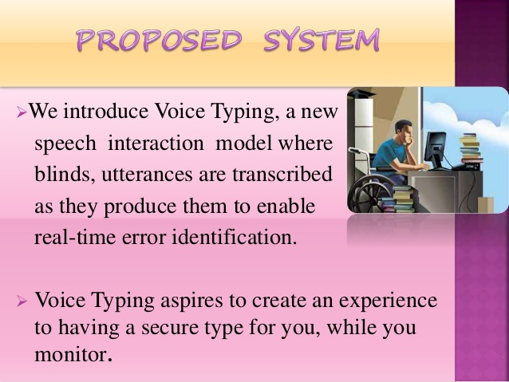

Slide 5
PROPOSED TECHNOLOGY
Voice Based Email System for visually impaired is proposed to be designed on the platform of :
NodeJs
React
MongoDB
WebSpeechApi

Slide 6
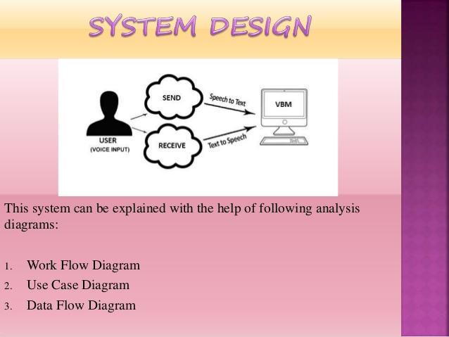

Slide 7
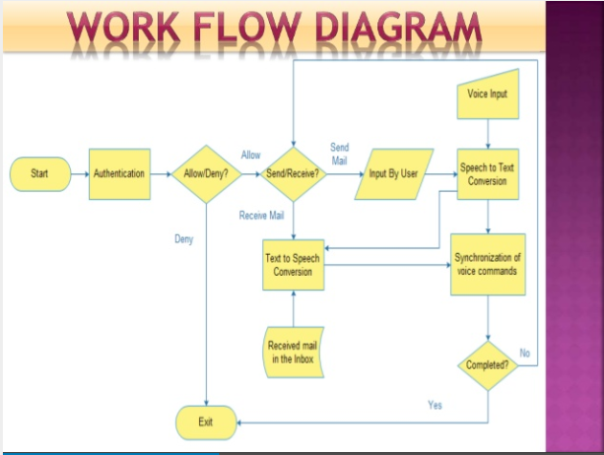

Slide 8
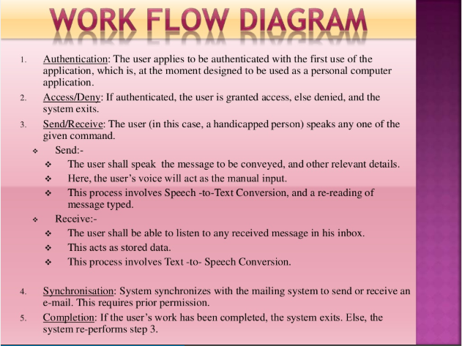

Slide 9
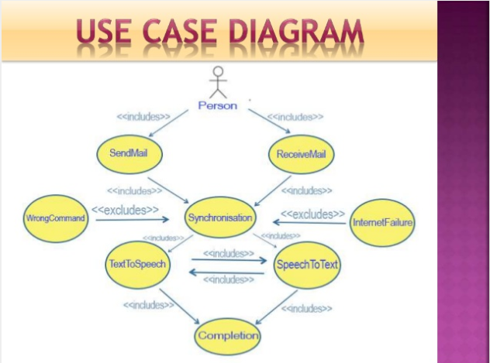

Slide 10
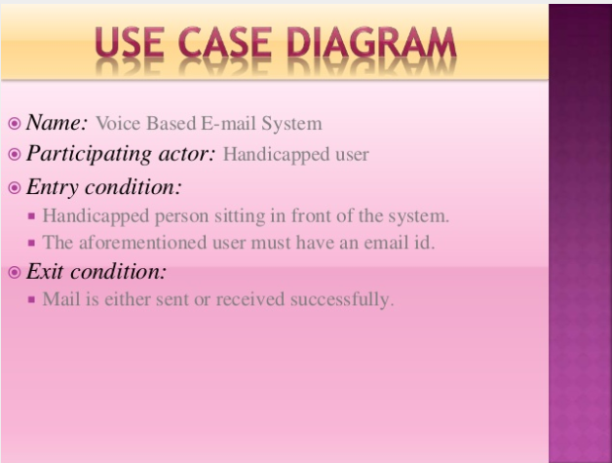

Slide 11
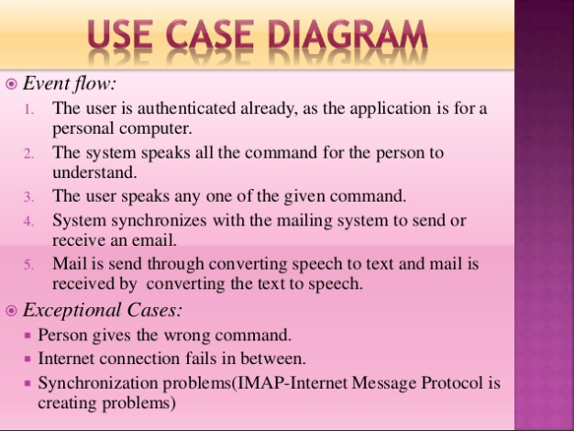

Slide 12
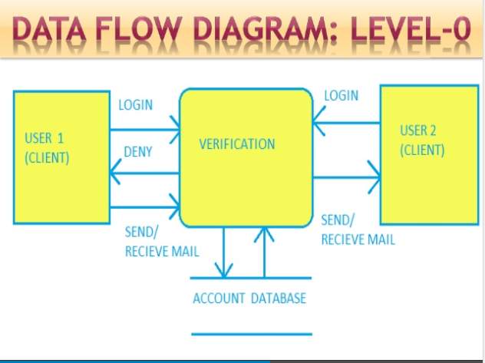

Slide 13
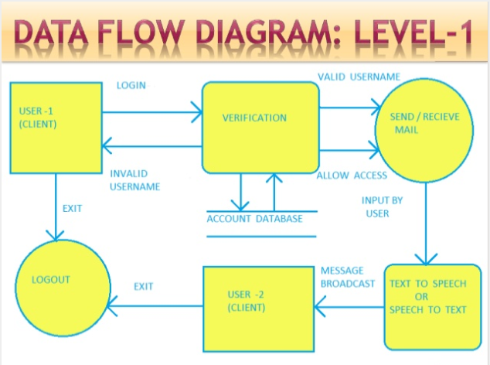

Slide 14
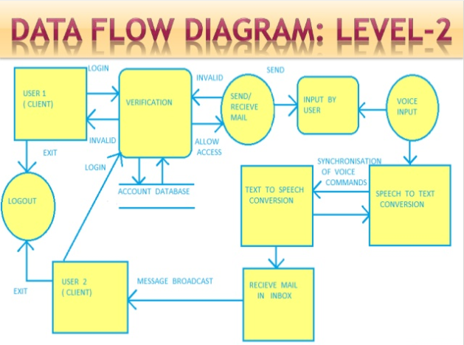

Slide 15
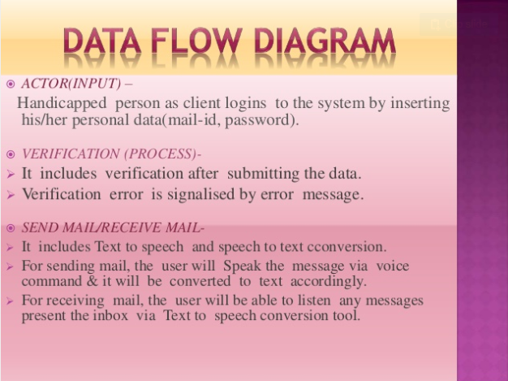

Slide 16
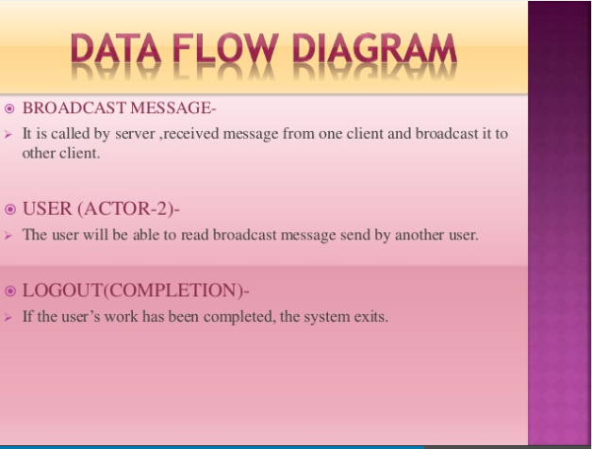

Slide 17
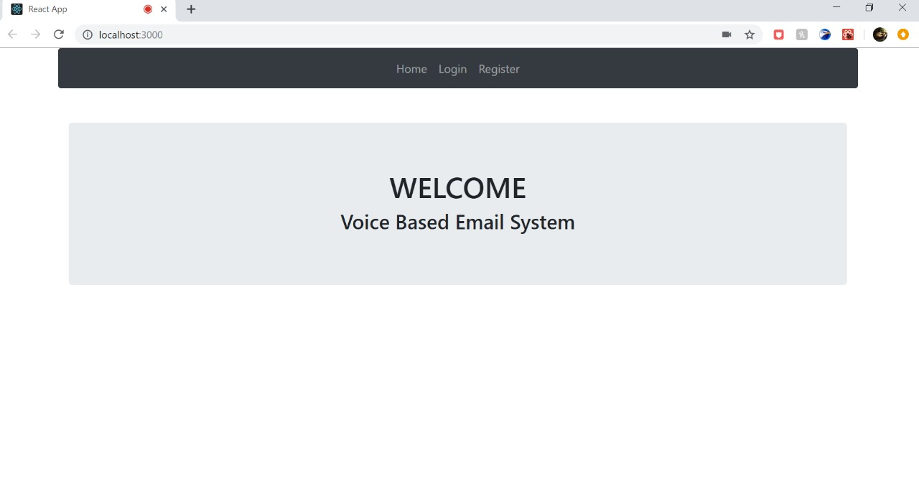
SCREENSHOTS

Slide 18
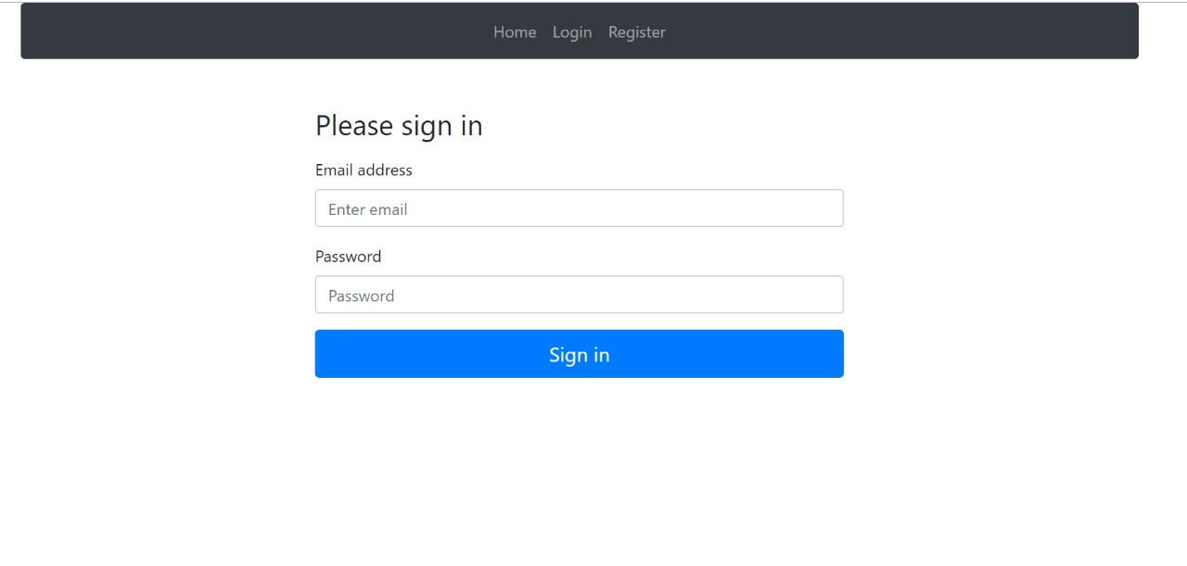
Fig 2: Sign-up & Login page

Slide 19
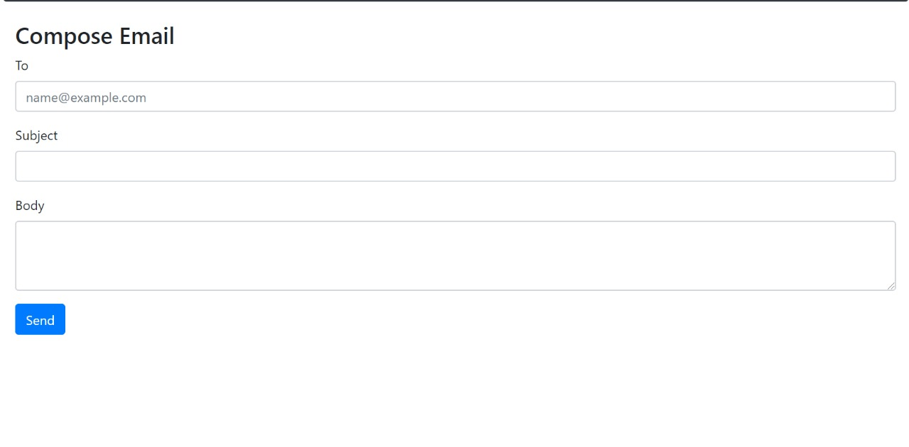
Fig 3:Compose Email

Slide 20
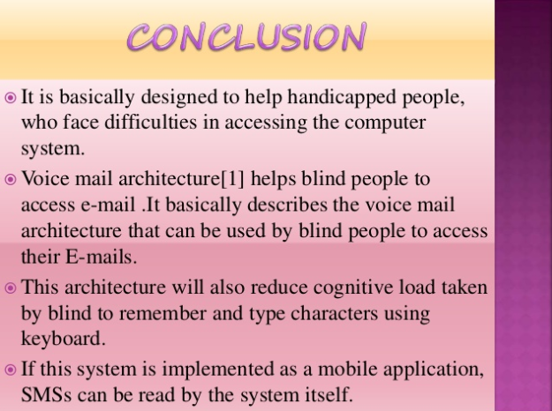

Slide 21


